Slide 1

GLOBAL COST OF LIVING
Presented By : Aya Ahmed
Mentorness | 2024

Slide 2
1
COST OF LIVING
This project revolves around the analysis of the cost of living in various cities and countries across the globe. The dataset used for this analysis encompasses a wide range of economic indicators, from the price of basic commodities to the cost of housing, transportation, and even entertainment. we aim to gain valuable insights into the economic disparities between different regions and understand the factors that contribute to the varying costs of living.
Mentorness intern| 2024

Slide 3

2
PREPROCESSING STEPS
Cleaning
Filtering
deleting nulls
Renaming columns
adjusting column formate
Add Calculated columns
Mentorness intern | 2024

Slide 4
3
OVERVIEW
1
Filtering the rows only includes countries, and cities whose data quality associated with it is equal (1), why? because when data quality = 0 suggests a need for more contributors and 1 indicates satisfactory data quality. By only including data quality =1 we ensure that our data is correctly presented .
Mentorness intern | 2024
we convert the data type from x1 to x55 to decimal numbers We will use it later to add calculated columns such as Transportation which include the sum of x28 to x33
, Groceries Expenses which include the sum of x1 to x 27
2
3
we also Calculate some measures for our visualization such as Average of Single Apartment which include 1 bedroom and family Apartment which include 3 bedroom, measure for correlation between Monthly salary and cost of living.

Slide 5
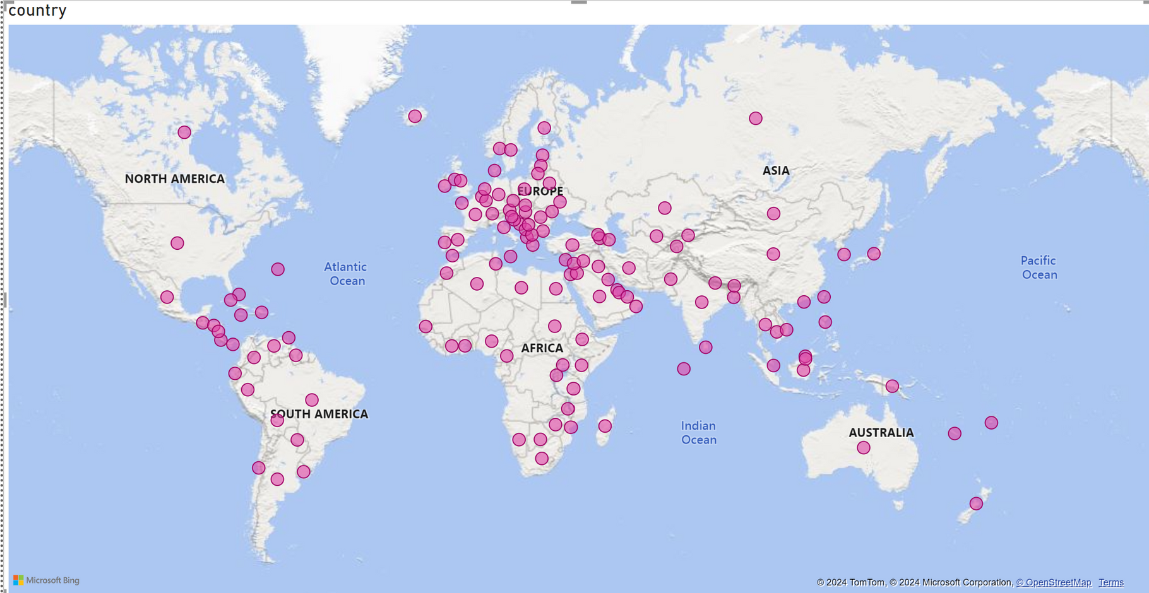
4
COVERED COUNTRIES
Mentorness intern| 2024

Slide 6
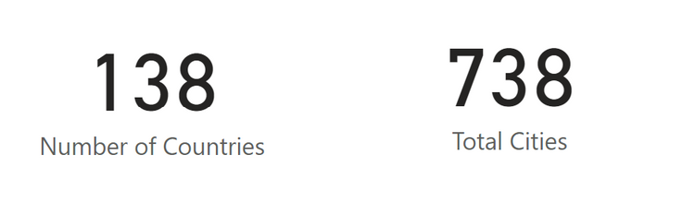
5
VISUALISATION
Overview
After Cleaning the data we have a total of
138 countries, and 738 cities.
it maybe we have small data set as they say (Trash in Trash Out) but we ensure that only good quality data are used to draw visualization
Mentorness intern | 2024

Slide 7
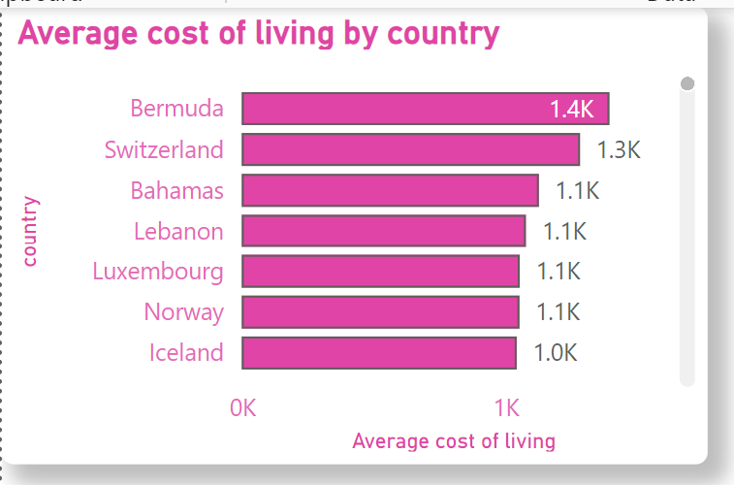
6
VISUALISATION
we calculate the measure Average Cost of living to use it in this next visualization as we can see here Bermuda, Switzerland is top 2 countries that has high cost of living
Mentorness intern | 2024

Slide 8
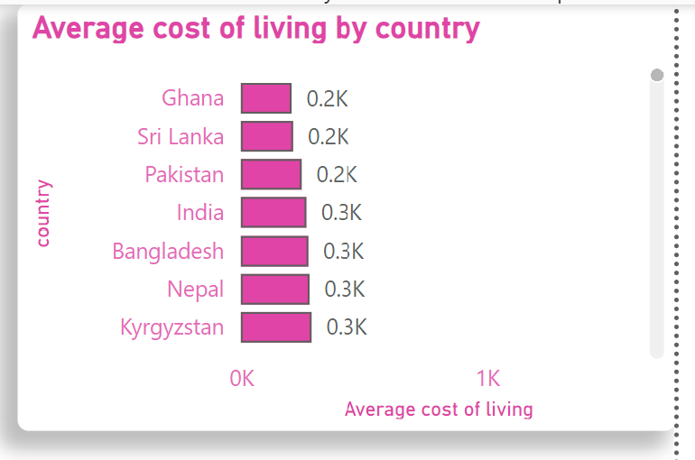
7
VISUALISATION
we also used the same measure to see the countries with low-cost living.
we used the same last graph and sort the result in ascending order
we can see here than Ghana, Sri Lanka is the top 2 countries which has low cost of living.
Mentorness intern | 2024

Slide 9
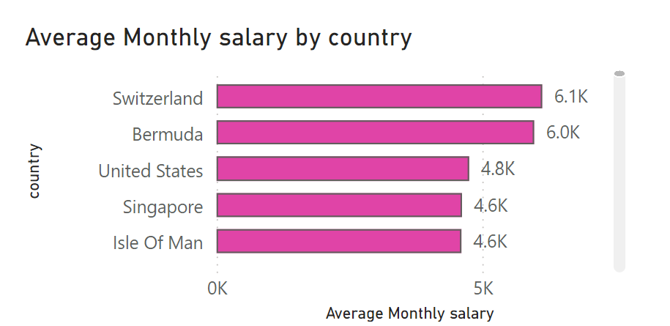
8
VISUALISATION
we add extra graph to gain more insights we can see here the top 2 countries that has high average salary is the same 2 countries which has high cost of living
Mentorness intern | 2024

Slide 10
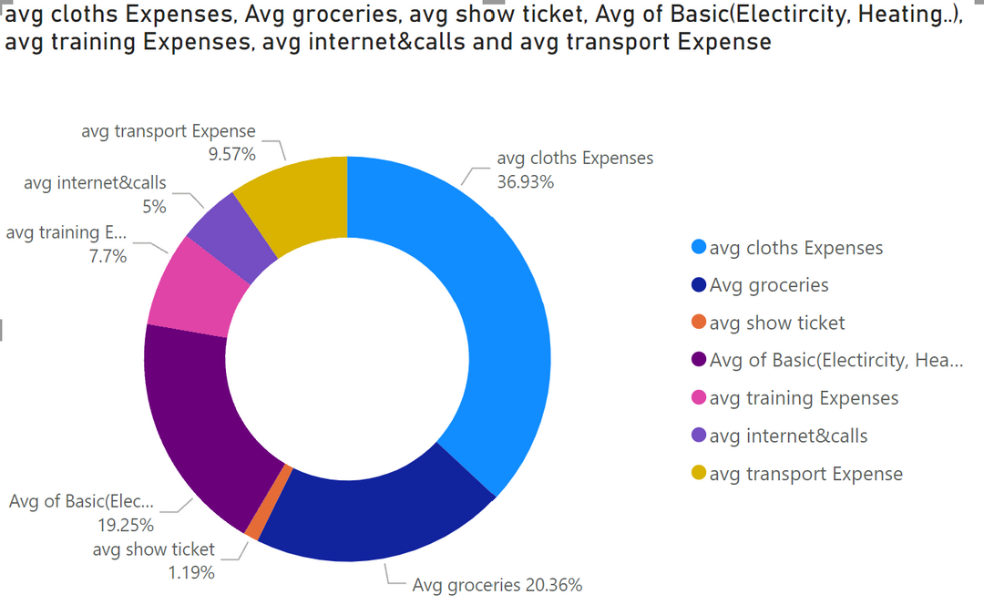
9
VISUALIZATION
We want to see which factor contributes the most to the cost of living. we include only the basic things like Transporation, Groceries, Cinema, Basic(Heat, Electricity , water...),internet, gym & sports).
we can see here that the Avg clothing Expenses (x44 to x47) nearly 37% of cost of living
Mentorness intern | 2024

Slide 11
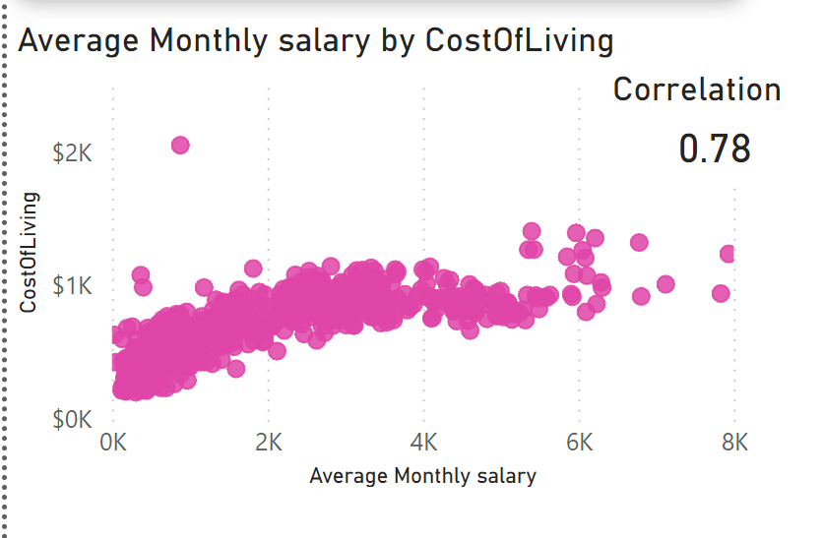
10
VISUALIZATION
we used the Average Monthly Salary measure to draw in this graph
we can see that there is a high positive correlation between these 2 variables (Cost of Living, Average Monthly Salary).
indicate that as the Average Cost of Living increases the Average Monthly Salary increases as well.
Recall that the same happens with Switzerland
Mentorness intern| 2024

Slide 12
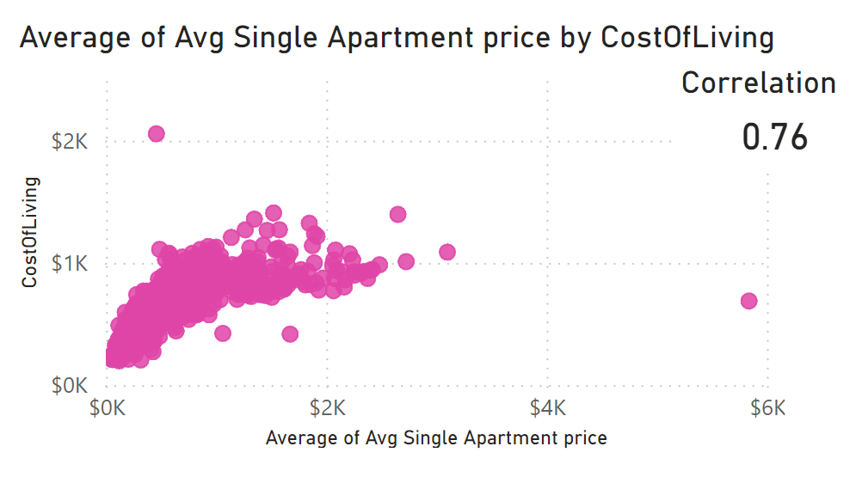
11
VISUALIZATION
We used the Average Single Apartment which has only one bedroom.
as we can see here there is a high positive correlation between these 2 variables which equal to 0.76 we used a quick measure to calculate the correlation coefficient between these 2 variables.
Mentorness intern | 2024

Slide 13
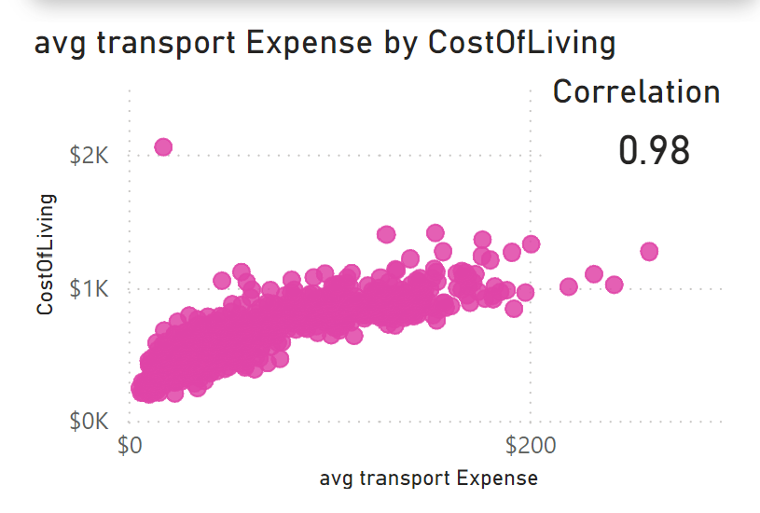
12
VISUALIZATION
we used the Average Transportation Expenses measure(x28 to x33) which include sum of (Gasoline 1 L, one month pass, Taxi 1 KM...)
we can see here a very high positive correlation between cost of living and Average Transportation Expenses which equal to 0.98
Mentorness intern | 2024

Slide 14

13
CONCLUSION
We recommend businesses to consider establishing manufacturing operations in low-cost living countries such as India. By doing so, companies can significantly reduce production expenses. The lower cost of labor, materials, and overall operational costs in India allow for more economical manufacturing processes. These cost savings can then be leveraged to enhance profit margins when the products are exported and sold in high-cost living countries like Switzerland. This strategic approach enables companies to maximize profitability while maintaining competitive pricing in premium markets.
Mentorness intern | 2024

Slide 15
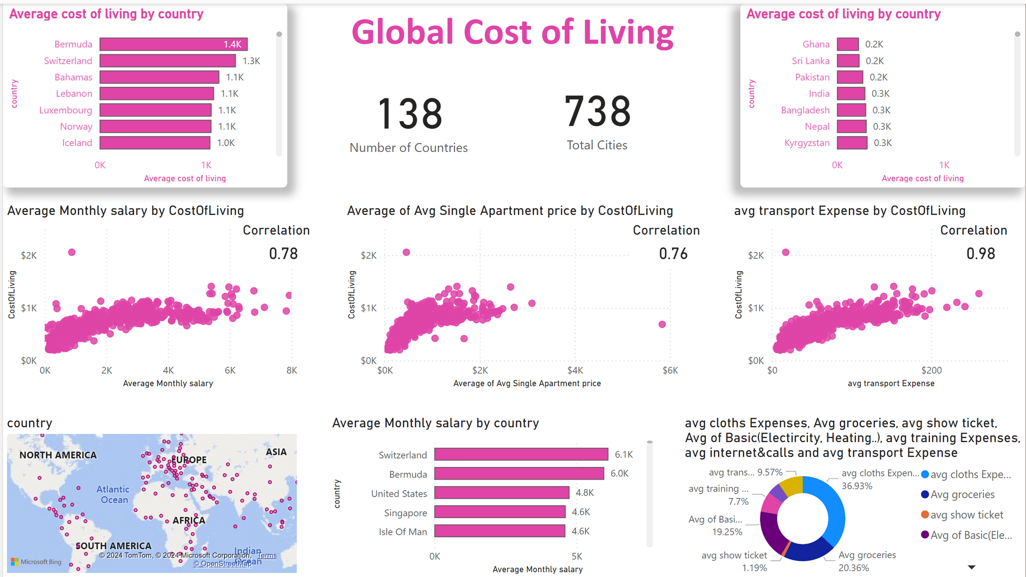
14
Mentoness intern| 2024

Slide 16
Mentorness intern | 2024
THANK YOU
Presented By :Aya Ahmed

